Slide 1
Stansbury Service Agency Work Meeting
12 July 2023

Slide 2
Agenda
The agenda items for this meeting are as follows:
1. Call to Order
2. Roll Call
3. Pledge of Allegiance
4. Review of Public Comments
5. General Manager Updates
6. Discussion Items
  Budget
  2023 Election – No Primary Decision
  Stansbury Days Events/Costs
  Solomon Park Loading Zone
  Delgada Park Fishing
  Hole 3 Water Issues
  Policy Committee Charter
  Friends of Stansbury Initiative
7. Board member reports and requests
8. Adjournment
9. Closed Session as needed to discuss personnel, pending or threatened litigation, or property acquisitions.

Slide 3




Review of Public Comments

Slide 4
General Manager Updates
Pool Update
  Aquatech reported a delay in delivery of boilers, now scheduled for Monday 17 July.
  Moving start of Lessons to Thursday, pending delivery.
  Offering families 5 punch pass for inconvenience
Solomon Park
  Contract to start landscaping signed Wednesday, 2 week start date.
  Need to address loading area.
Fishing/Swimming area.
  Vendor looking at bulk pricing for floats and docks
  Options for Swimming area outline
  Delgada Park Design

Slide 5
General Manager Updates
Porter Way Park Bathroom
  Awaiting final siting decision by SPID
Millpond Park
  Location of Final Bathroom Siting
  Final overall park design
  Select Final Contractor for Parking Lot
Soundwall Trail
  Land Use Decision
Golf Course Upgrades
  Greens Resod improved comments about course
  Material to begin Sprinkler upgrade delivered on 12 July.

Slide 6

Budget

Slide 7
Financials Update
Bank Accounts Balance as of 7/11/2023:
Personnel Costs:
Golf Course Revenue:

Slide 8
2023 Election
No Primary decision

Slide 9
Stansbury Days

Slide 10
Events and Costs
As of 07/06/2023

Slide 11
Solomon park loading zone

Slide 12
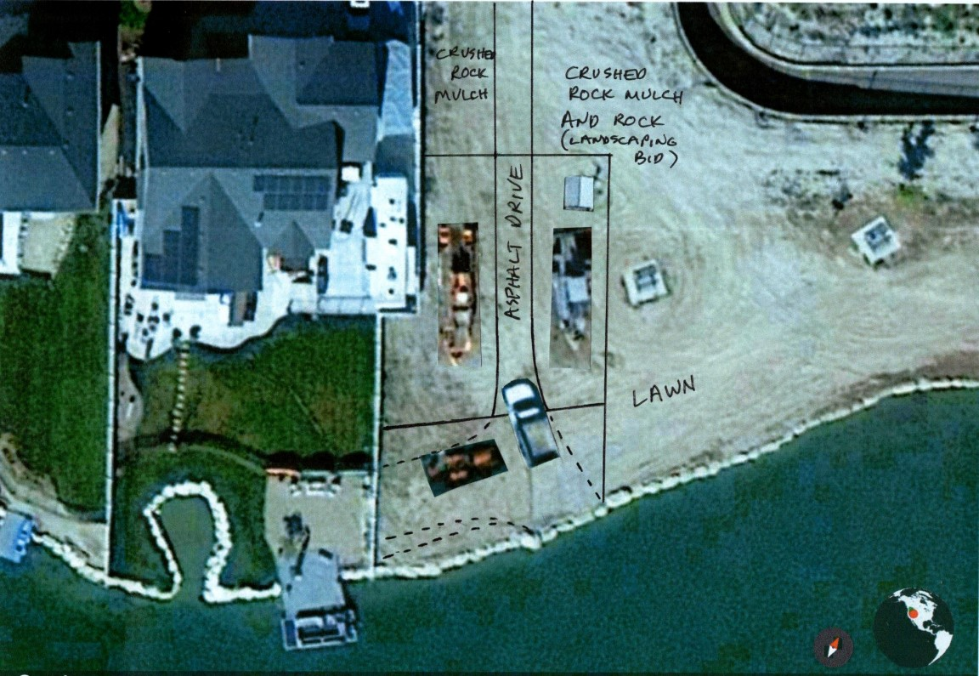
Loading
Zone

Slide 13

Delgada Park Fishing

Slide 14
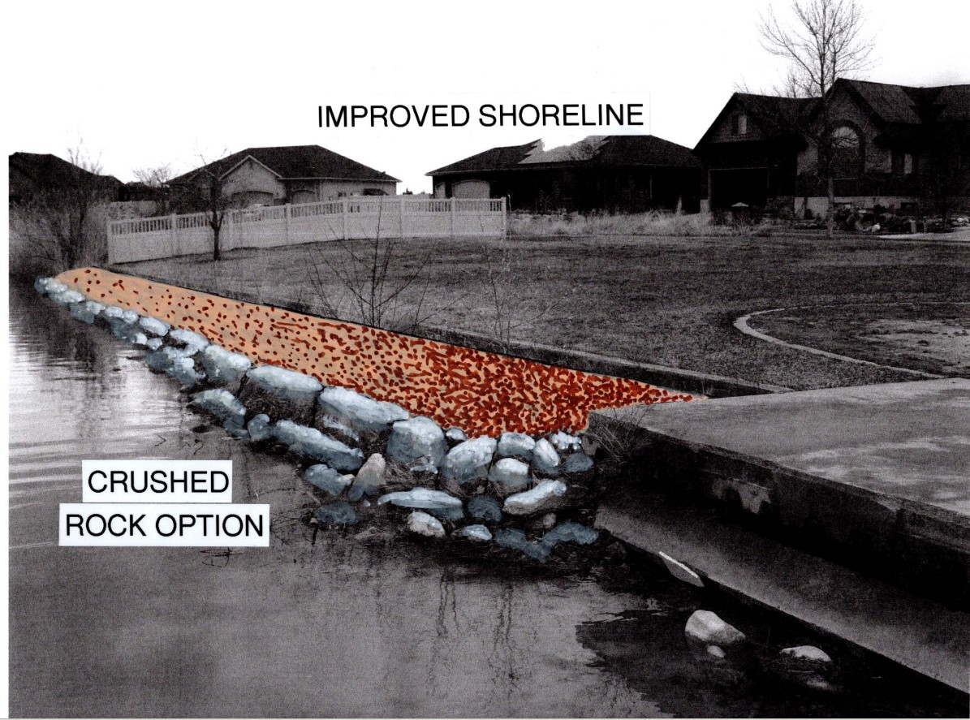
Picked Option

Slide 15
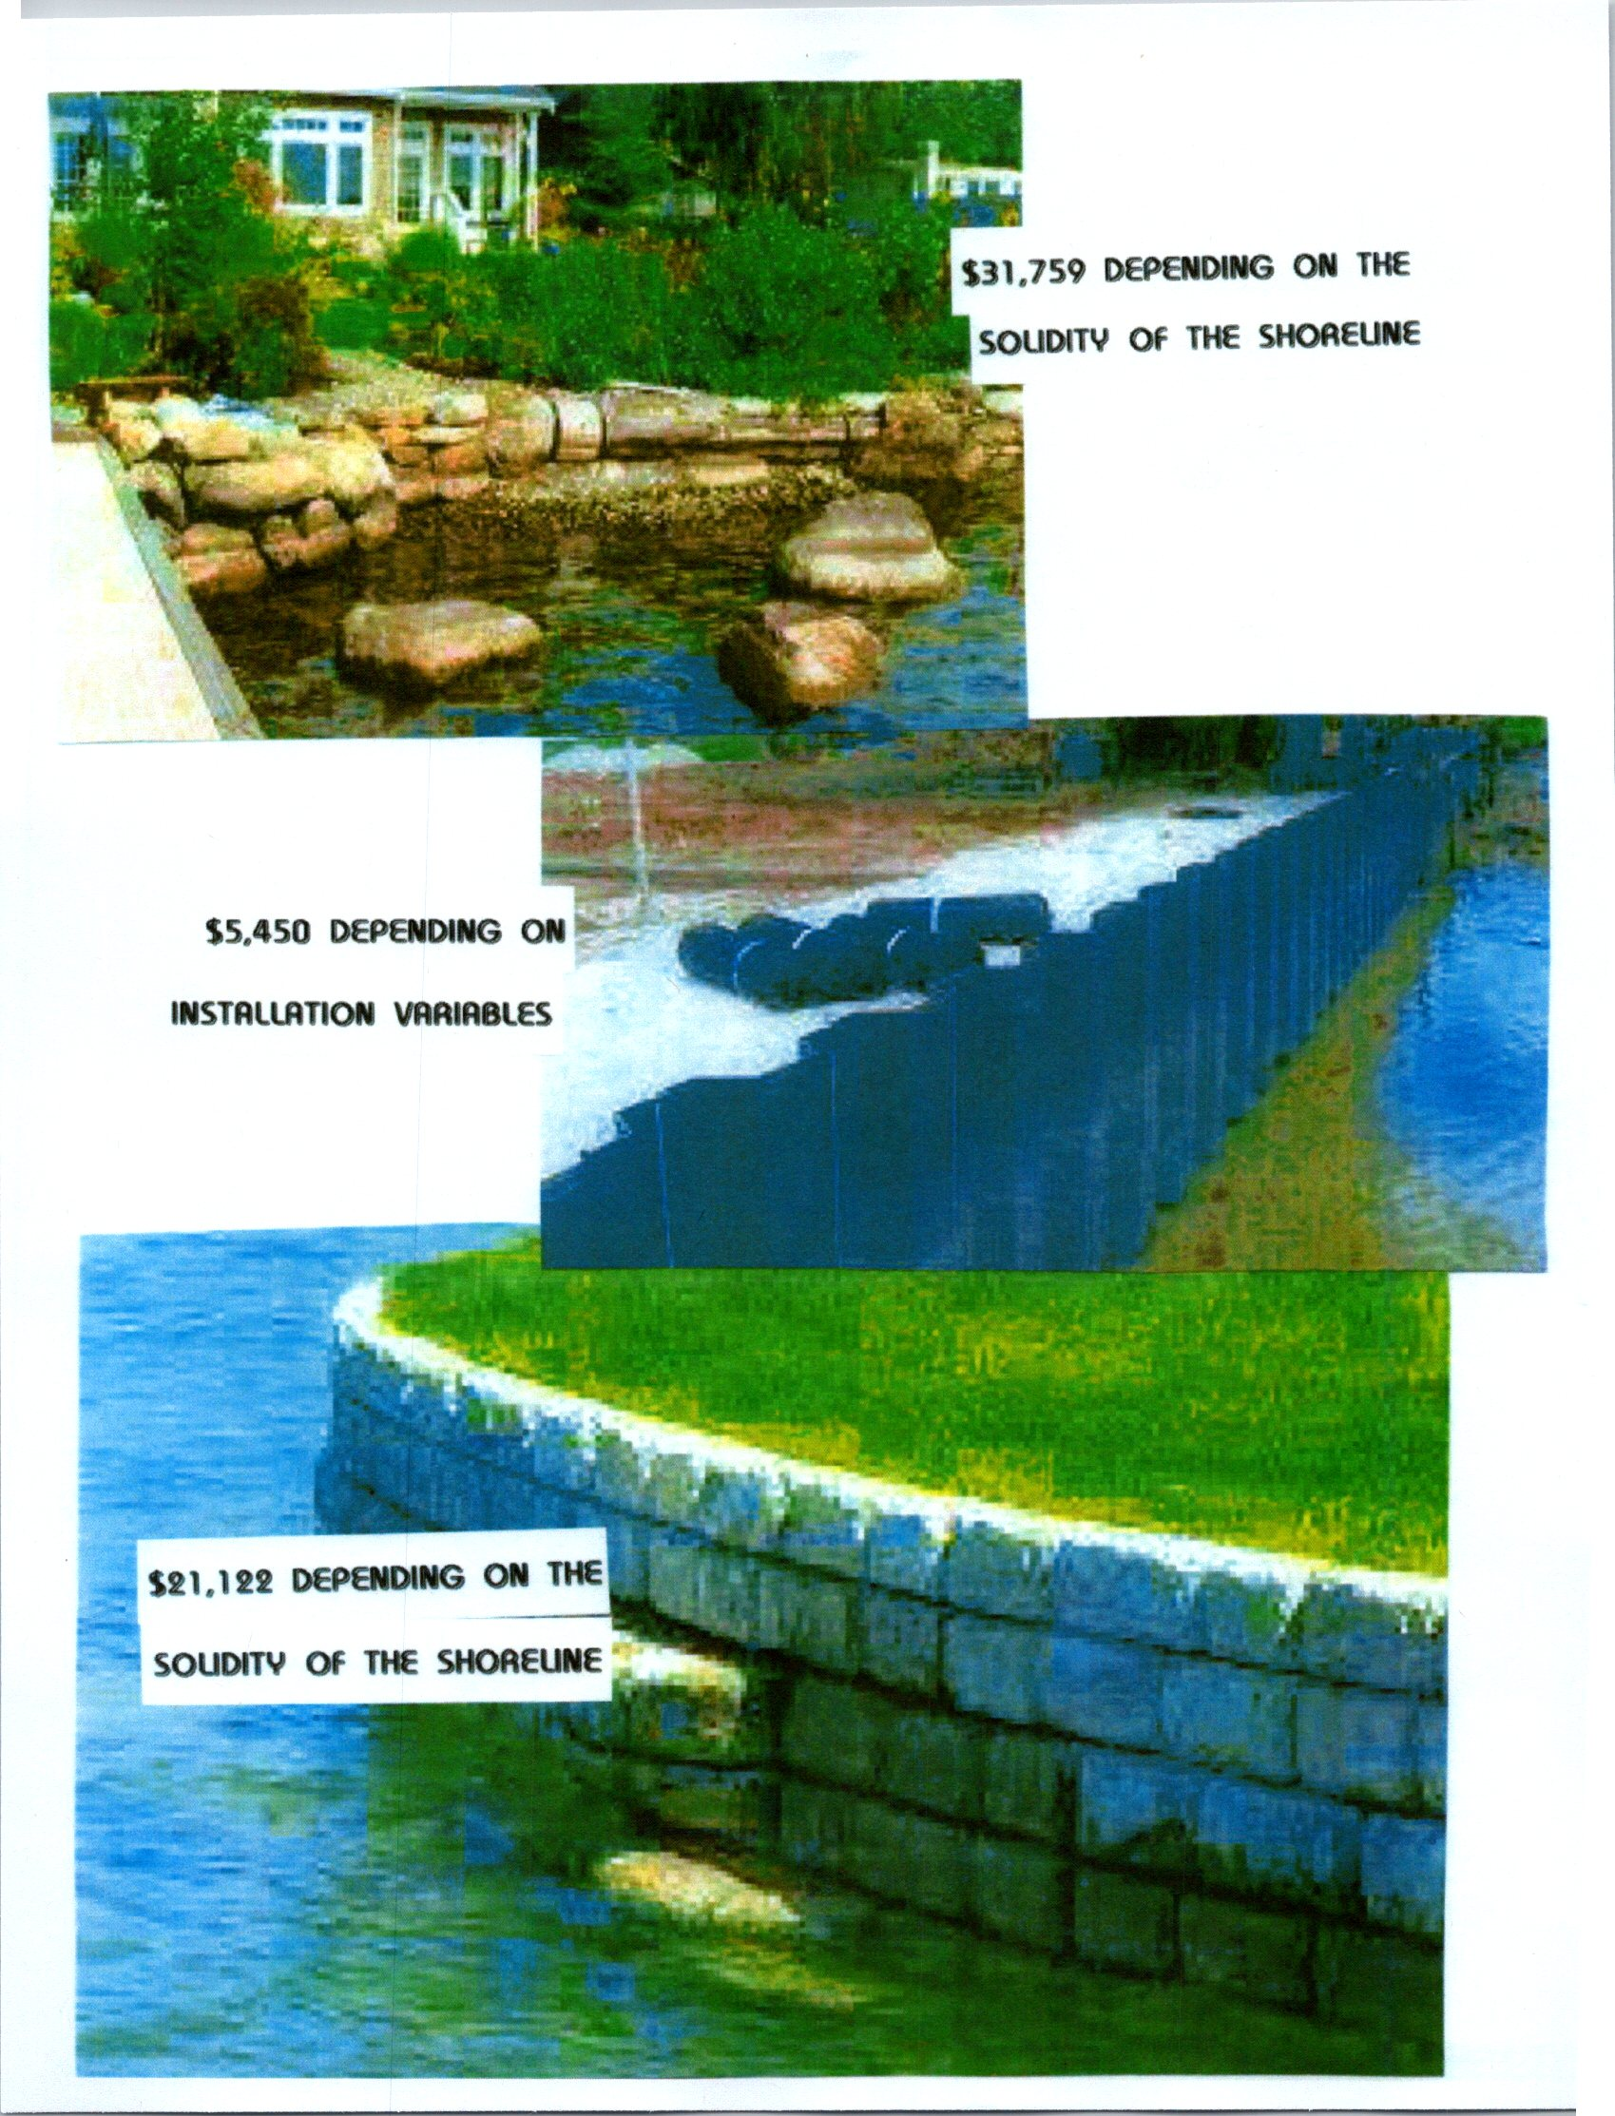
Lake Front of Delgada Park

Slide 16
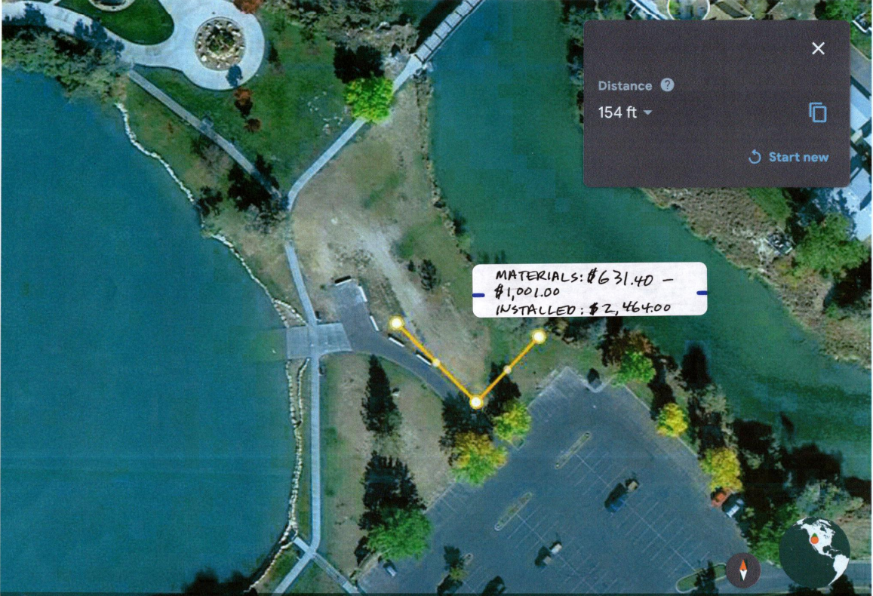
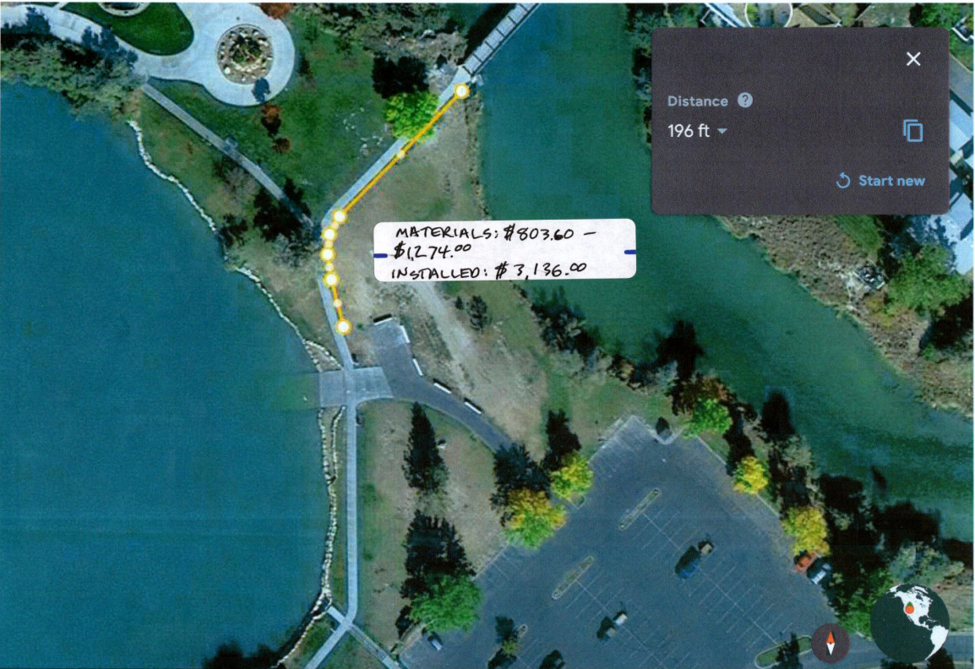
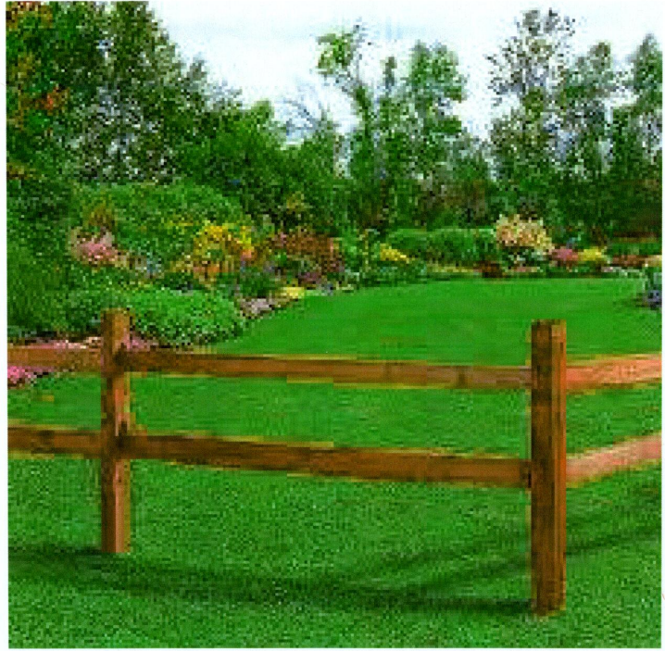
Option for Clubhouse water front

Slide 17
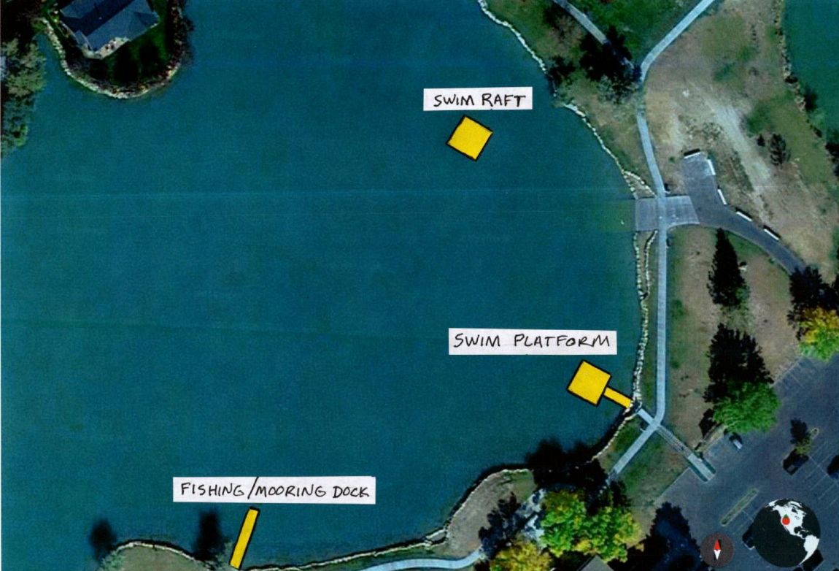
Location of Docks at Clubhouse Waterfront

Slide 18
Water Issues Near Hole 3
Current System Not Functioning Properly
Proposed Fixes
  Repair/Replace Weir
  Roto and Sleeve Line West of Weir
  Add Flapper to Pond
  Repair or Replace Pump Head

Slide 19
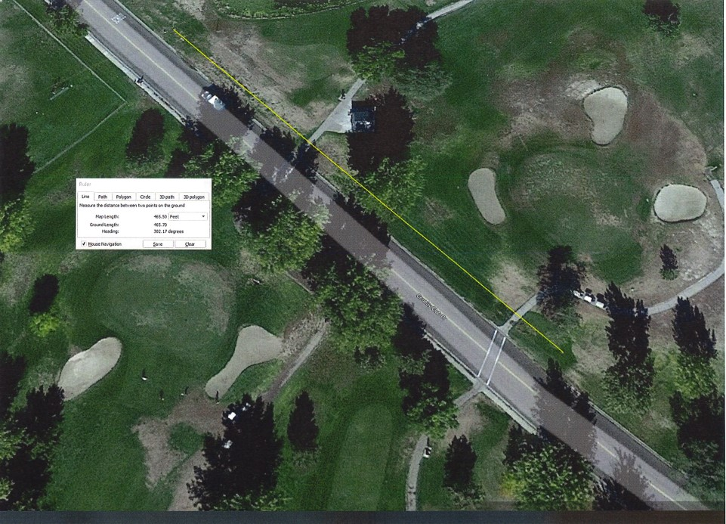

Slide 20
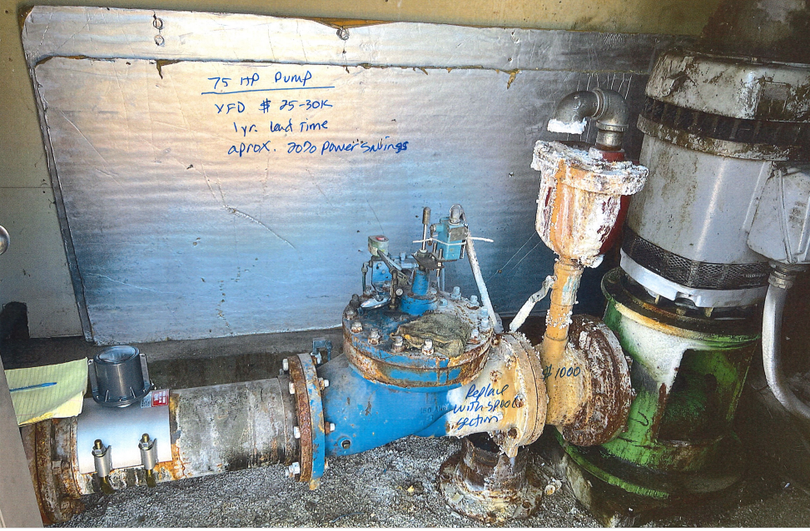

Slide 21
Repair Cost Options
Clean out west end pipe
  Clean and video - $1500
  Clean, video and sleeve - $65K
Repair/Upgrade Gordon Well Pump
  Remove/Valve at Junction - $1000
  Turn and Replace Speed Sensor - $2500
  Add a Variable Speed Drive to Well Head - $25-30K
Repair Replace Weir
  Add back flow pocket - $1000
  Repair/Replace Weir
  Replace Weir with control Box - $25K

Slide 22
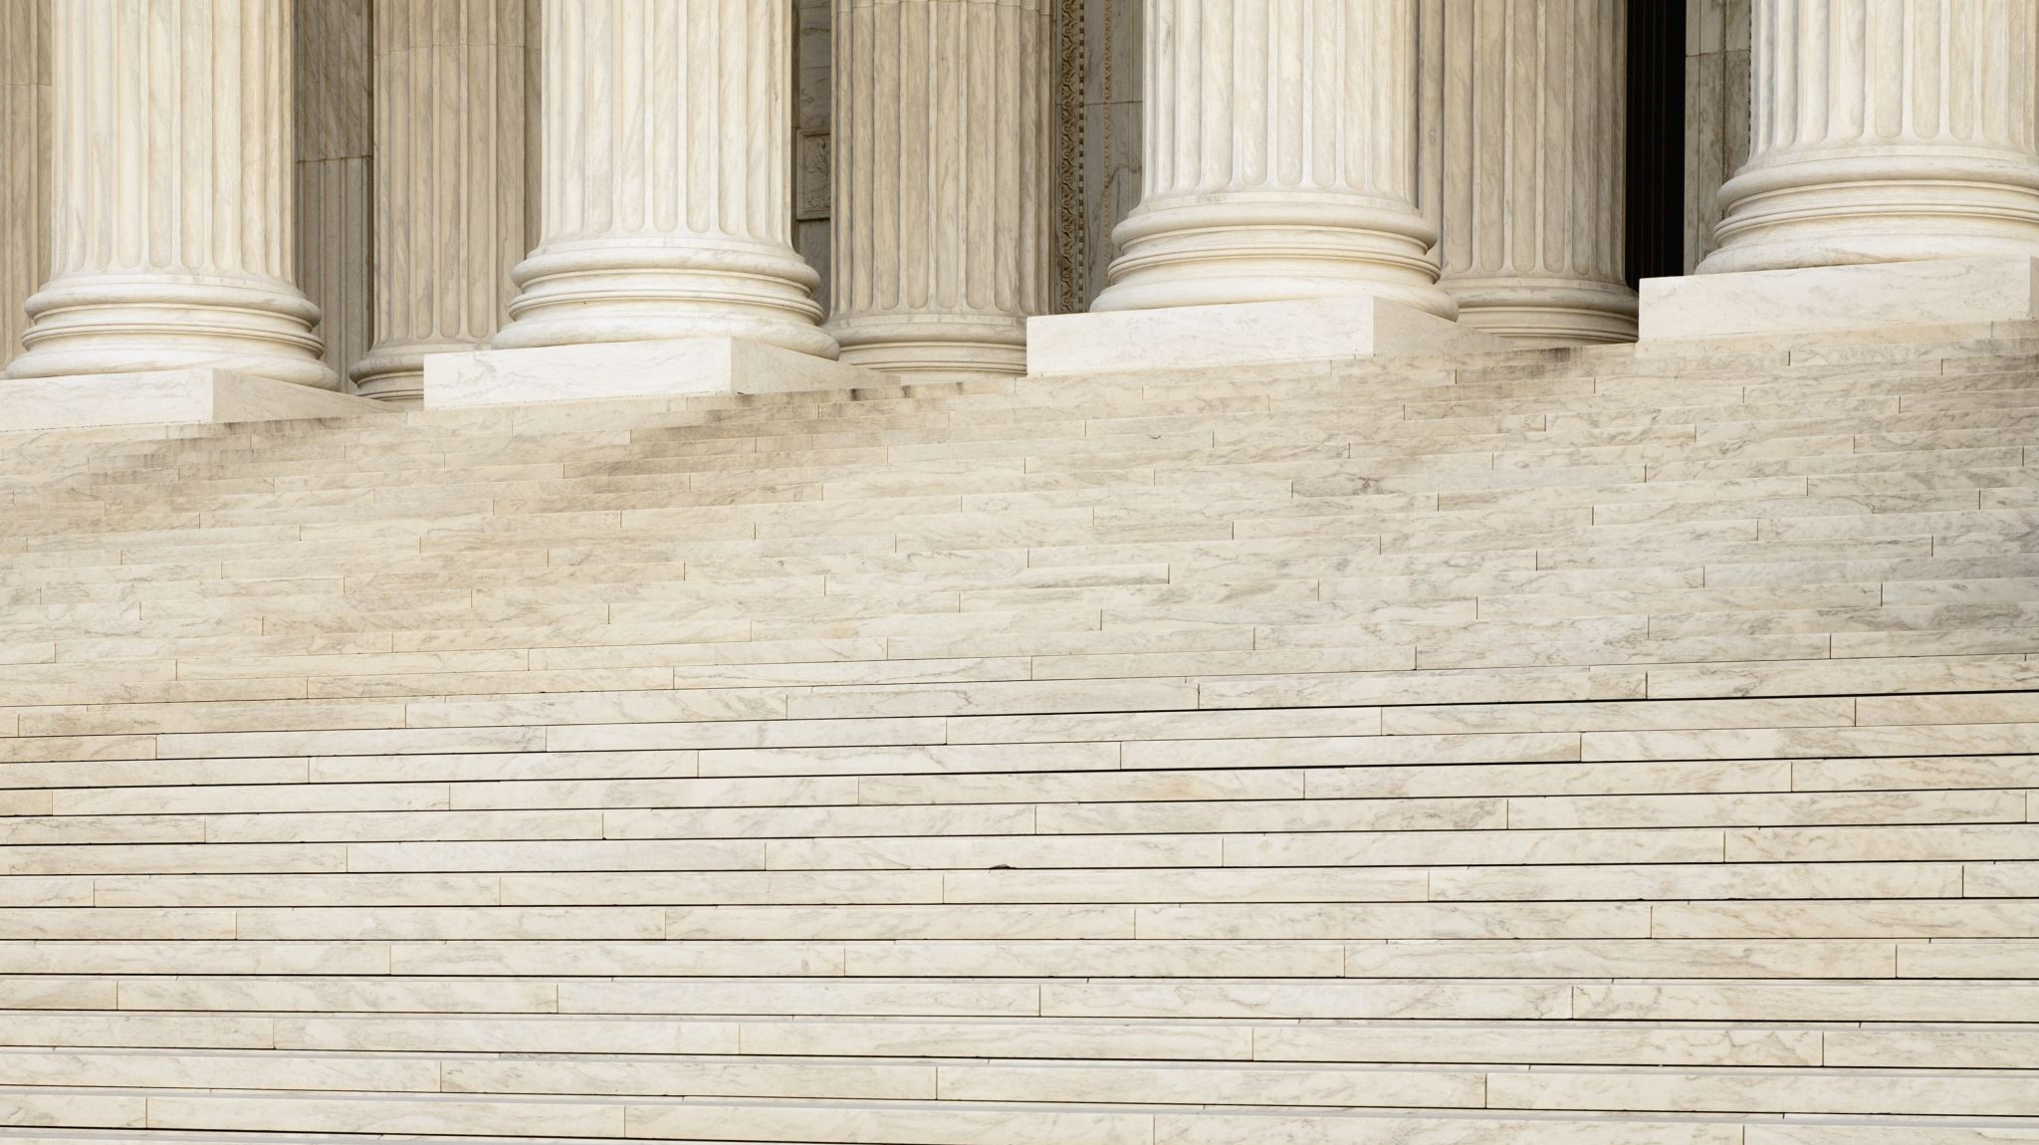
Updated Policy Committee Charter

Slide 23
Friends of Stansbury Intiative

Slide 24

Board members reports and requests

Slide 25
Closed session

